Slide 1
Cardinal Rules 2021
Presenter’s Name
Meeting Title
Date
Location

Slide 2
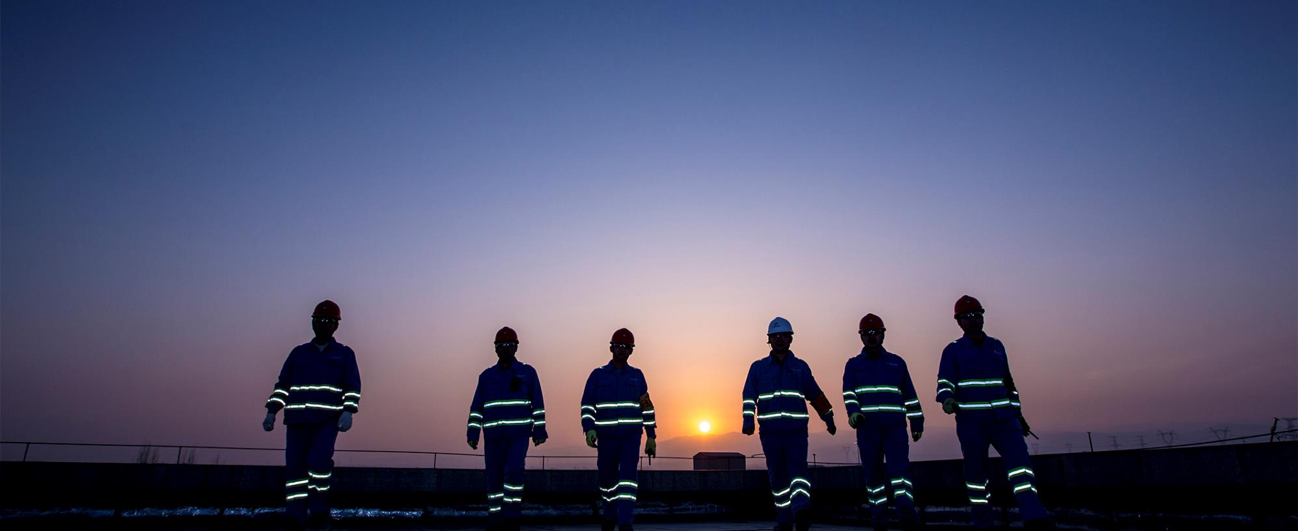



AGENDA
How did Harsco develop the Rules?
What are the Harsco Cardinal Rules?
What happens if a Cardinal Rule is violated?

Slide 3
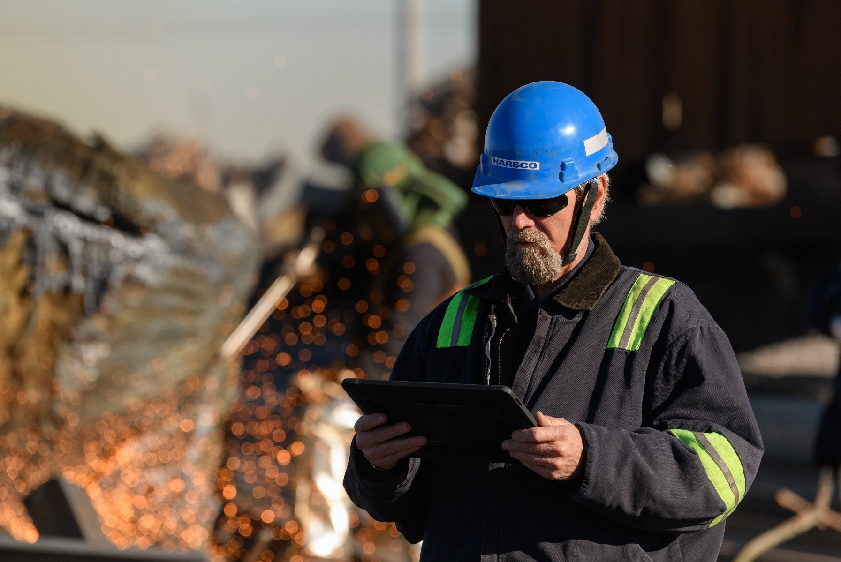



HOW?
HARSCO CARDINAL RULES WERE DEVELOPED FROM:
01
02
03
Review of significant risks across Harsco operations
Review of potentially fatal incidents that have occurred within Harsco
Benchmark - review of equivalent rules models across the industry
These rules are not new hazard controls, they have been embedded in our procedures and work practices for many years.

Slide 4
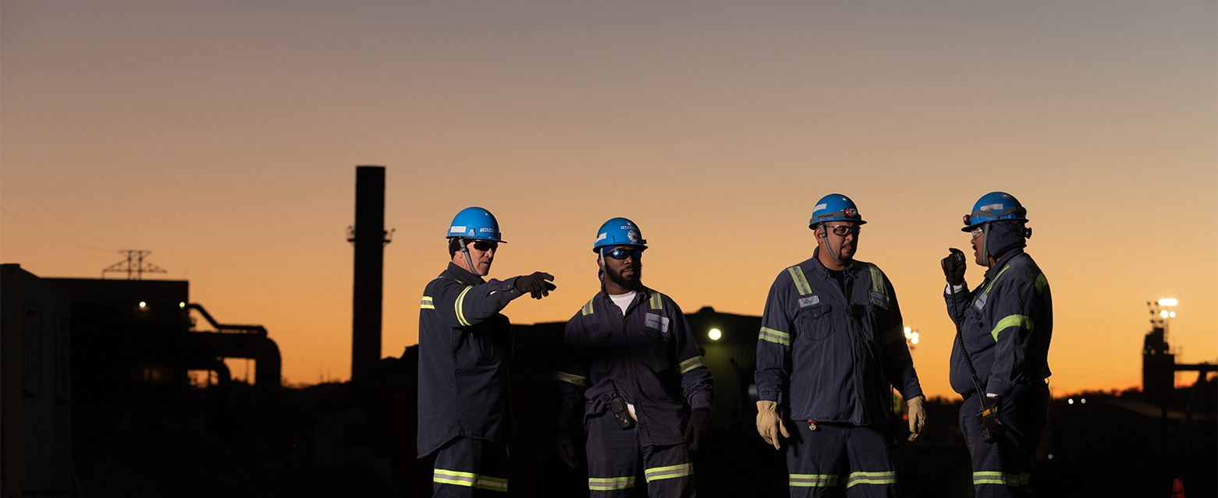
WHAT?
Cardinal Rules have been established to help prevent
potentially fatal risks across Harsco.
Used together with management risk controls they
will produce the safest way to perform our activities.
The Rules are hazard controls that are within the power of all employees, contractors, agency workers and visitors to apply; as well as being personally accountable for complying with them.

Slide 5
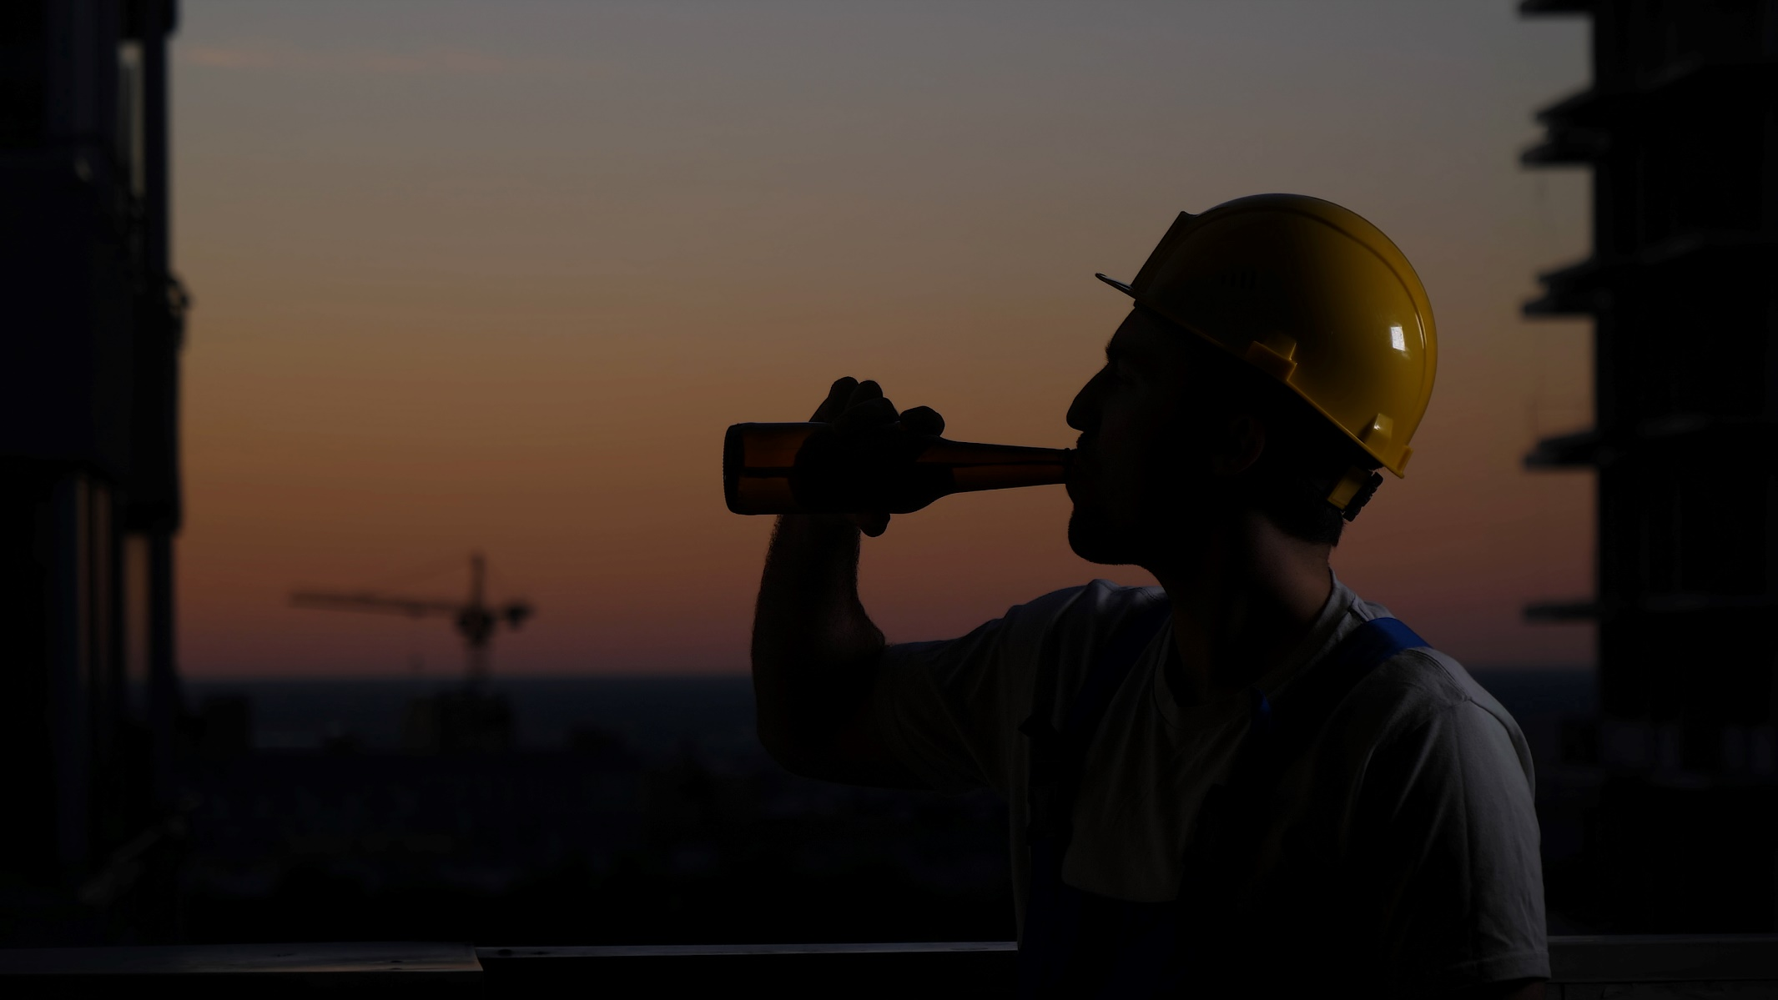
THE RULES
  1
Drug and Alcohol
Fit to Work
I WILL always report to work in a fit condition and FREE of drugs and alcohol.
Notes:
People affected by any level of alcohol or other drugs are not allowed onto any Harsco premises.
The effects of alcohol and other drugs can reduce your ability to do the work safely.
Prescription medication need also to be considered and discussed with your doctor. If your performance can be affected Harsco should be informed about it.

Slide 6
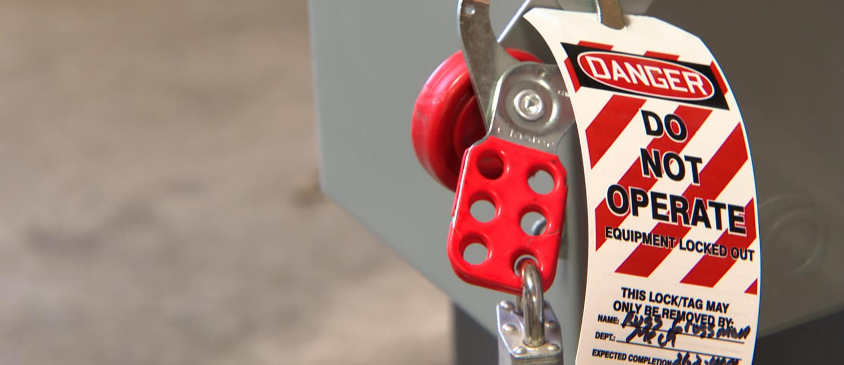

THE RULES
  2
Lock out Tag out
I WILL always follow the lockout, tag out, try out (zero energy) procedure, and follow the required permits.
Notes:
Electricity, process line pressure and temperature, mechanical energy, spring energy, and hydraulic pressure are common hazards encountered in our operations.
Make sure you are trained and certified to conduct activities involving energy and you have the resources for complying with the procedure.

Slide 7
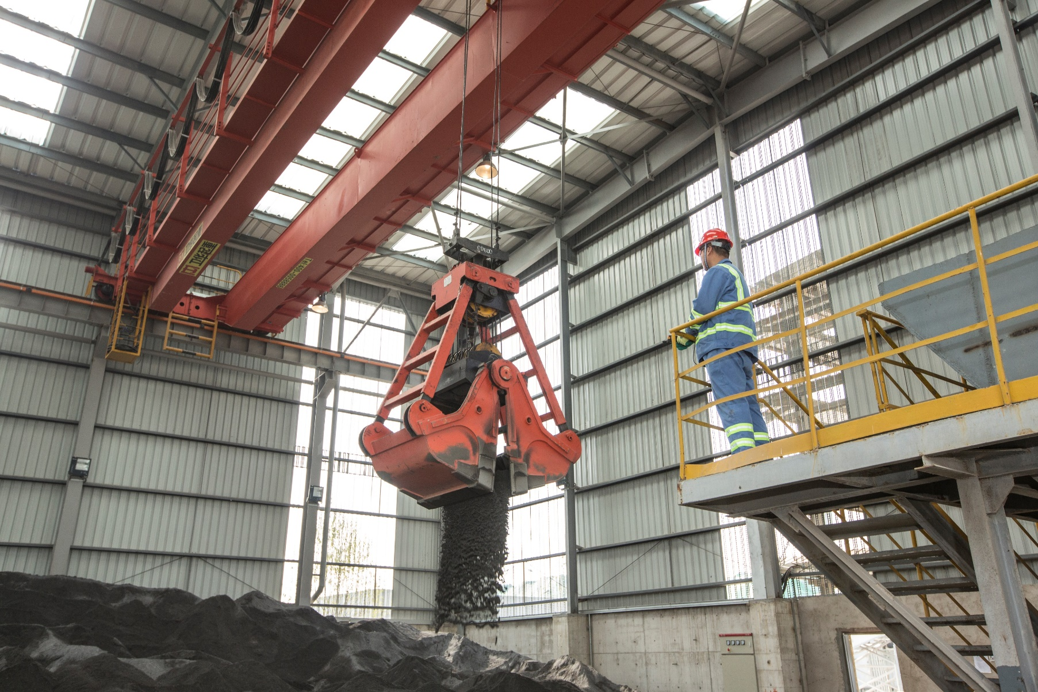

THE RULES
  3
Safety Devices
I WILL always ensure no safety devices are bypassed or disabled.
Notes:
Safety devices exist to protect you and others.
No one has the authority of bypassing a safety device without proper risk assessment and leadership permission.

Slide 8
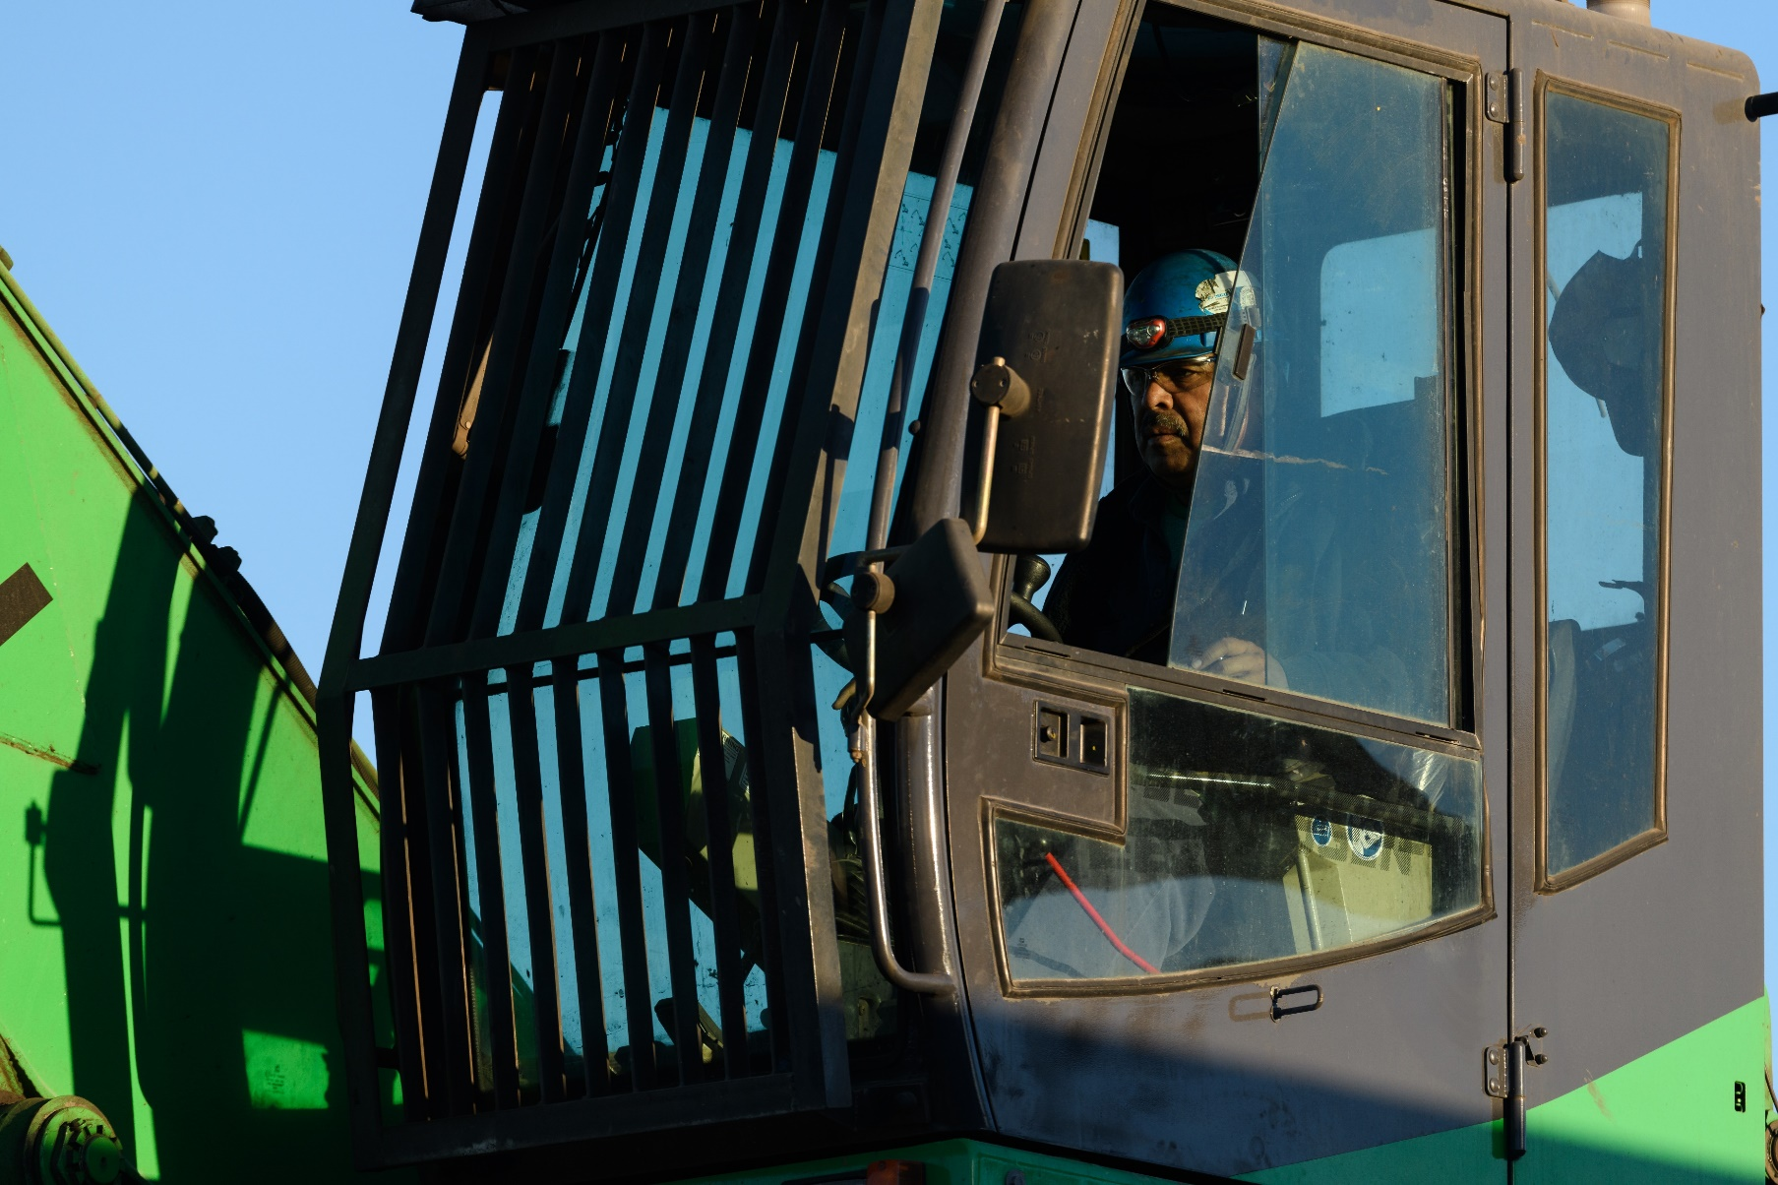

THE RULES
  4
Equipment
I WILL only operate equipment that I have been trained and authorized to use.
Notes:
You should never operate equipment that you have not been trained to use.
You have the right to refuse to operate any equipment that you have not been trained to use.
If you have been trained, but believe you need a refresh, you should ask for it.

Slide 9
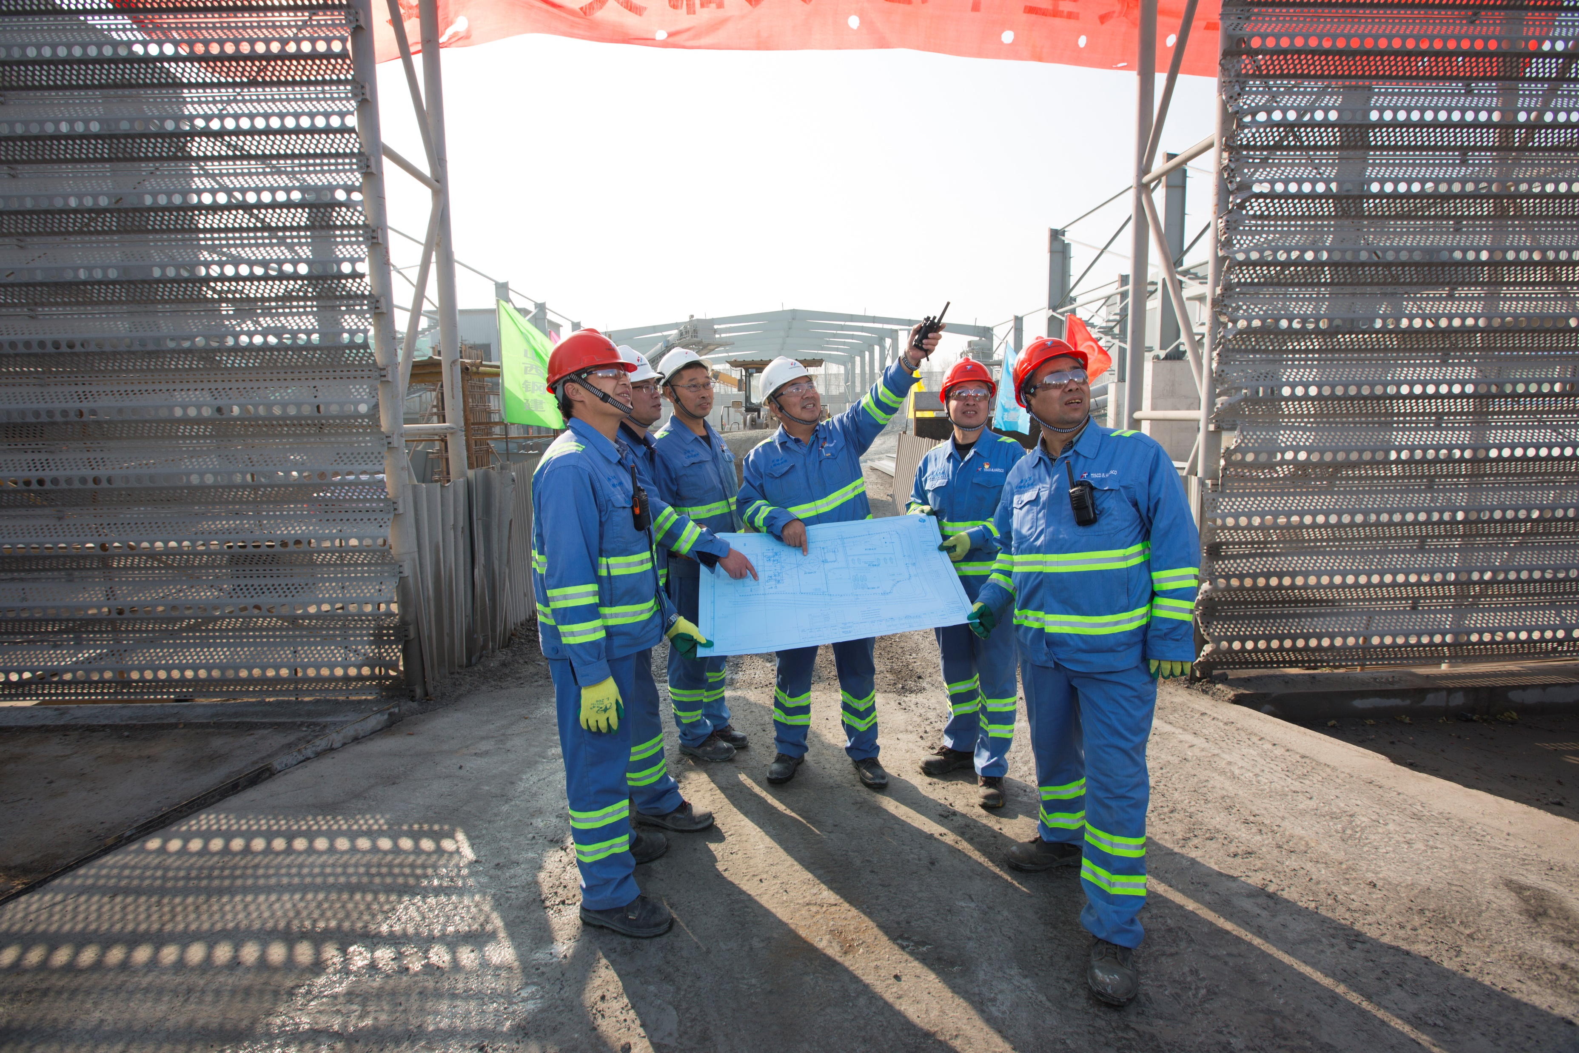

THE RULES
  5
Operational Procedures
I WILL always respect the standard operational procedure for the task I am conducting and will intervene with anyone who works in an unsafe manner.
Notes:
All routine activities must have an updated procedure and risk assessment.
I must be trained and qualified to do my task.
Non-routine activities must have a risk assessment.

Slide 10
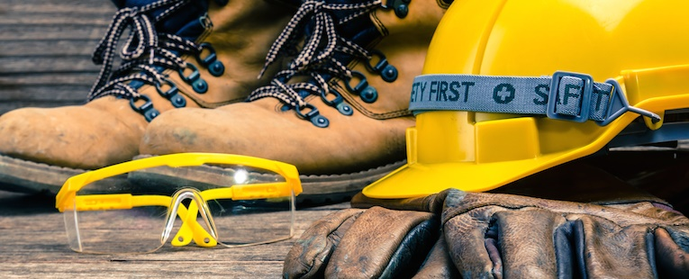

THE RULES
  6
PPE – Personal Protective Equipment
I WILL always use the defined PPE for the task I undertake.
Notes:
You are responsible for maintaining and using all PPE designated for the tasks you perform.
If the designated PPE is not available, you have the right to refuse to do the task.
If your PPE is damaged, hand in your old PPE and ask for a replacement.

Slide 11


THE RULES
  7
Incident Report
I WILL always immediately report all incidents that I witness and fully cooperate in any resulting inquiry.
Notes:
All near misses, property damages, and injuries must be immediately reported to the leadership at the Harsco site you are.
All incidents must go through an investigation process to assure preventive measures are defined and implemented, as well as shared within the Organization.

Slide 12

THE RULES
  8
“3 Points of Contact”
I WILL always use “3 points of contact” when mounting/dismounting mobile equipment, platforms, stairs & ladders.
Notes:
All employees must follow the 3 points of contact all the time while mounting and dismounting equipment.
You must report all damaged and missing handrails/steps/stairs immediately to your line manager and assure proper fixing.

Slide 13
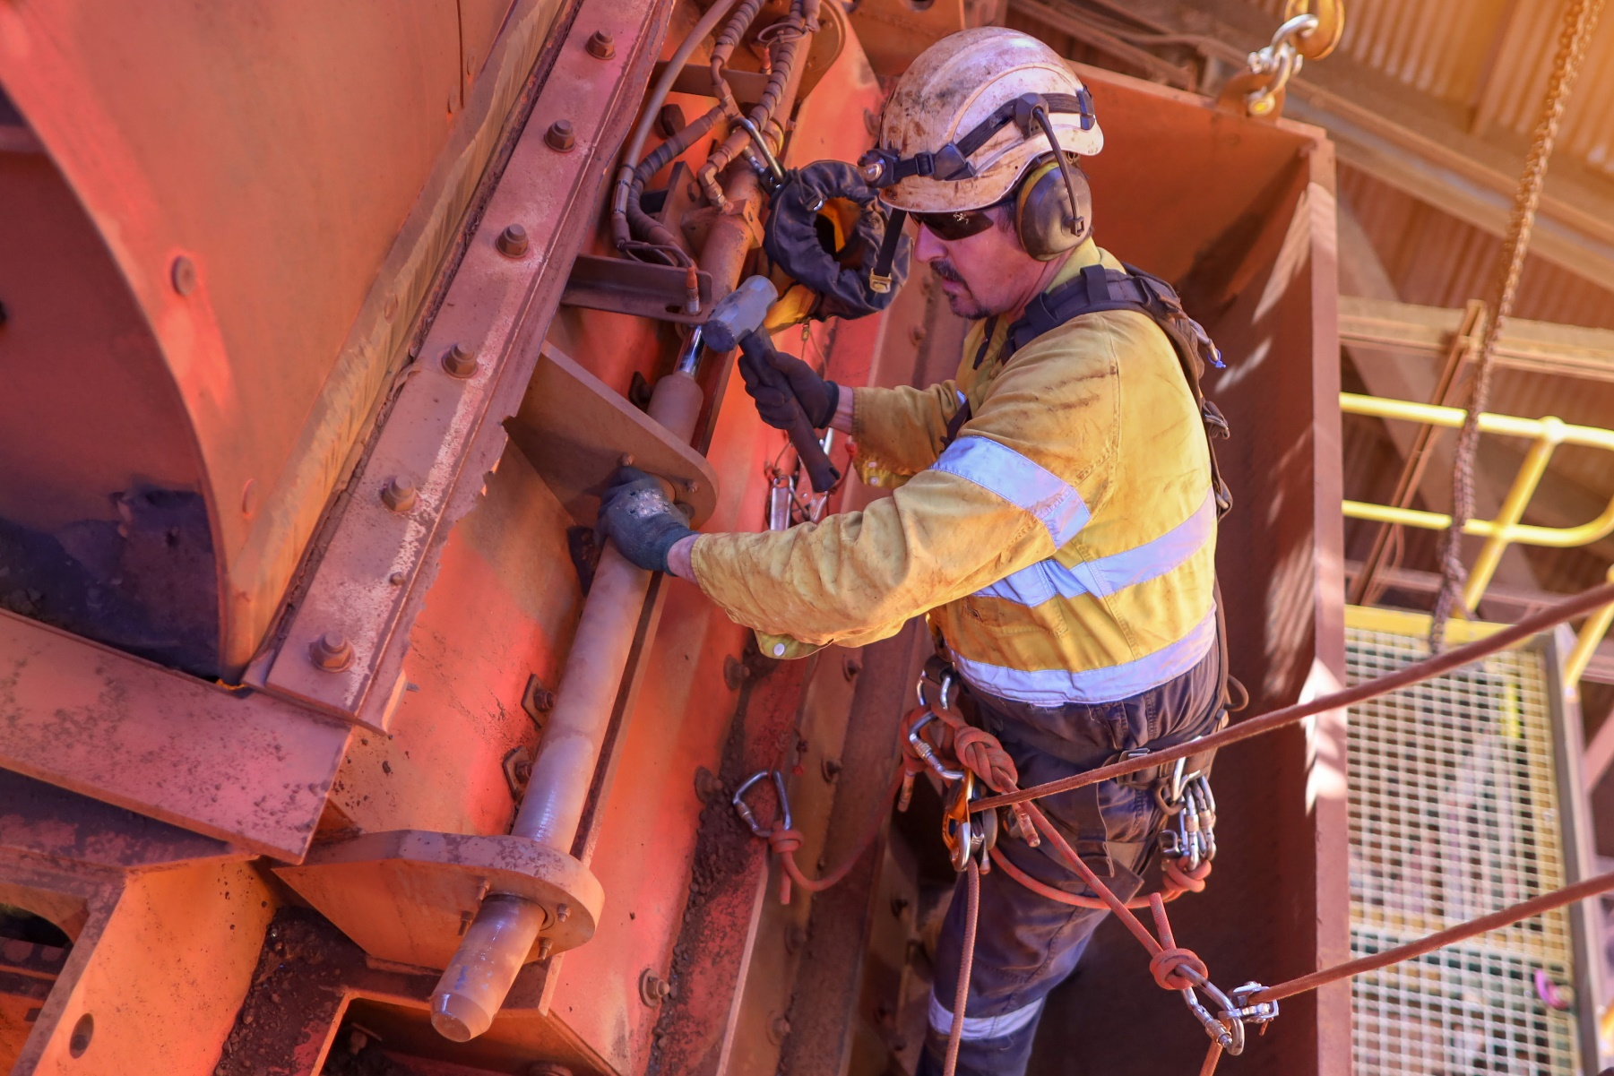

THE RULES
  9
Work at Height
I WILL always use the right equipment for the task when working at height and ensure it is inspected before use.
Notes:
I will always follow the hierarchy of controls process (elimination, substitution, engineering controls & personal protective equipment) to ensure I have the right equipment for the task.
Working at height training is essential to understand all the fall protection requirements & specific rescue options available.
Always check your equipment is in good condition before starting the task.

Slide 14

THE RULES
  10
Mobile Phone
I WILL never use a phone while operating equipment or driving on site.
Notes:
A handheld mobile phone must not be used whilst driving, operating machinery, or a mobile plant.
If you have to make/receive a call, go to a designated safe place to do it.

Slide 15

WHAT HAPPENS AFTER A RULE BREAKING?
  1
  2
  3
When considering the findings of the
investigation, a fair process will be
followed in determining the appropriate
disciplinary action.
If there appears to be a violation of a Cardinal Rule,
a full investigation will be undertaken.
Findings will be reviewed by local senior
management, including HR and Legal.

Slide 16


BECAUSE I CARE...
The application of Cardinal Rules is another step in
demonstrating that you care for everyone´s safety.
You have the authority to stop the work if you feel it is unsafe to continue a particular task.
With this authority, you have the responsibility to
find a safe way to do the task.
There’s always a safe way to do things!

